Slide 1
Comparison with Koochesfahani et.al(1989)
(03/28/2019)

Slide 2
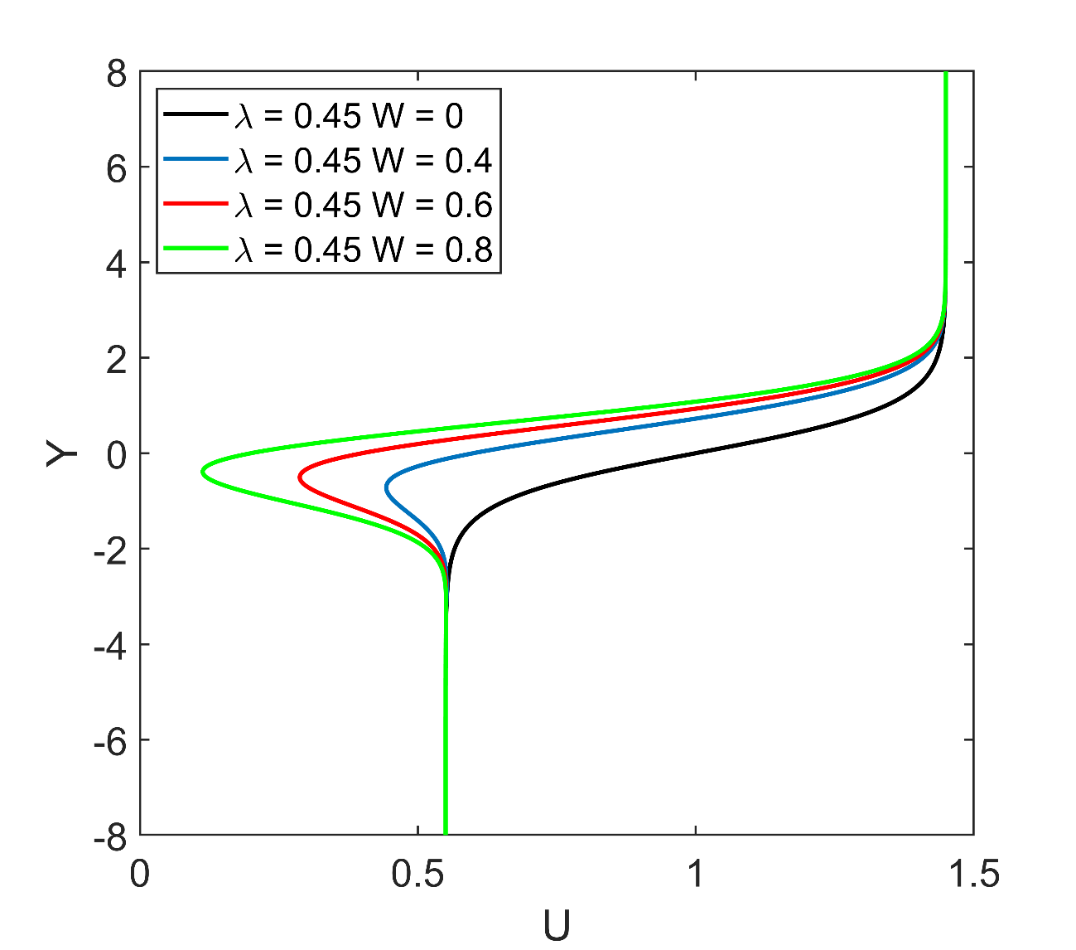
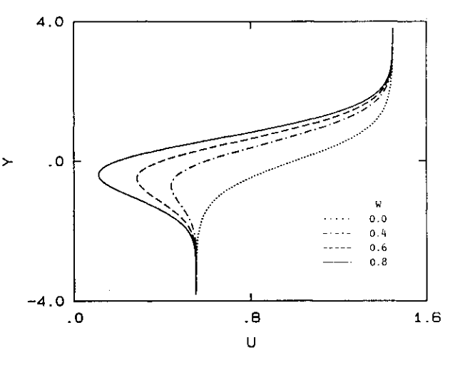
Velocity profiles
Koochesfahani & Frieler 1989 AIAA Journal

Slide 3
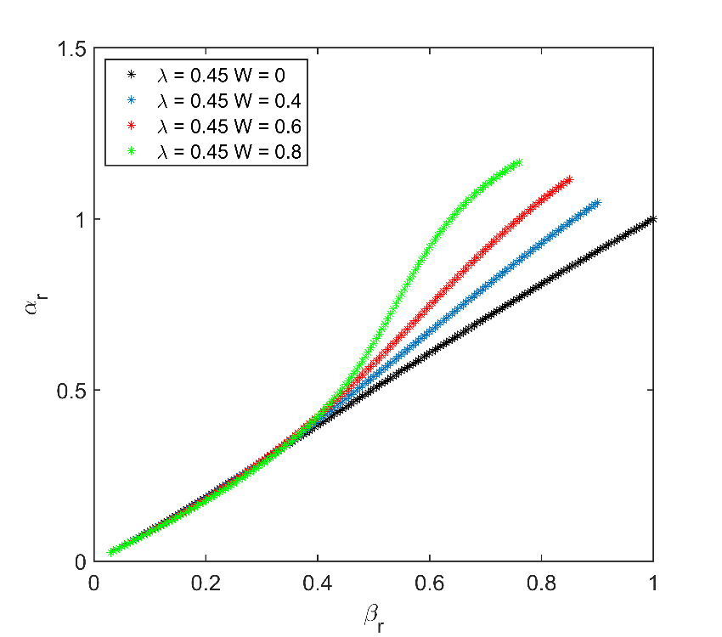
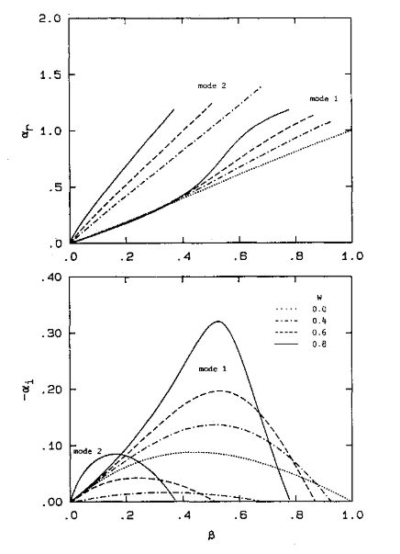
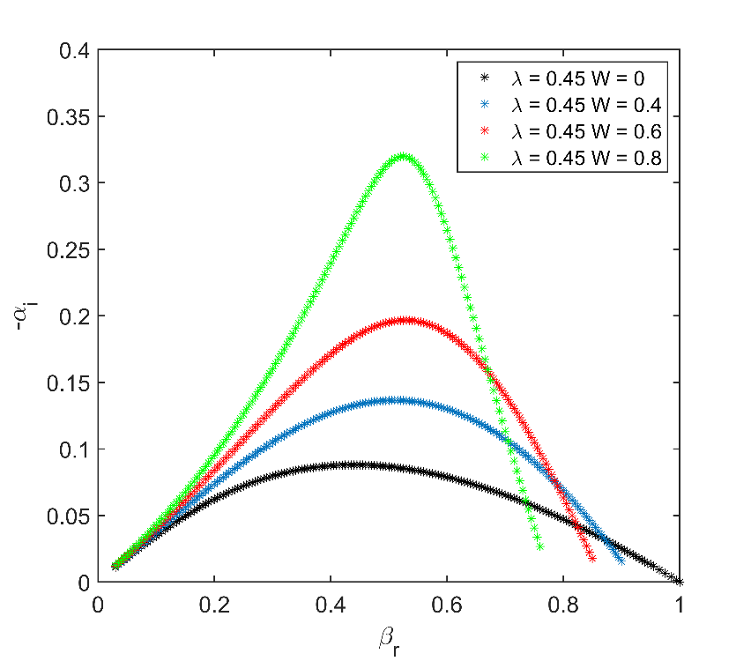
Growth rates
Koochesfahani & Frieler 1989 AIAA Journal

